Slide 1
Malaysian Islamic Equity Trend Prediction (MIETP)
Shobana Athiappan
Pavitra Vengattarao

Slide 2
Content:
Business Understanding
Data Understanding
Data Collection
Crawling
Automating
Next milestone planning
Code Walk-through

Slide 3
Business Understanding:
What is Malaysian Islamic Equity.
Shariah Compliant Funds: Investment funds governed by Shariah Law and the principles of Muslim religions.
Consider to be type of social responsible investing.
Untapped field of investment since it has just expended in popularity recently.

Slide 4
Business Understanding:
Shariah Compliant type of FUNDS:
Equity Funds.
Private Equity Funds.
Trade Finance Funds.
Real Estate Funds.
Money Market Fund.

Slide 5
Business Understanding:
What we are trying to achieve :
To create awareness on Islamic Equities, and Shariah compliance investment.
To prescribe and predict the Trend in Islamic Equity.
To develop an Machine Learning Forecasting Web-app based on this product.

Slide 6
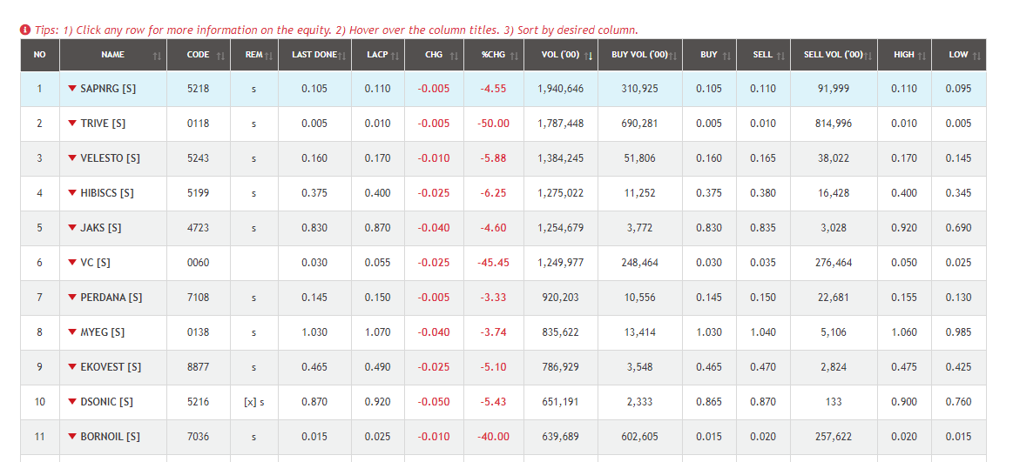
Data Understanding:
Our primary source of data is from Bursa Malaysia.
URL : https://www.bursamalaysia.com/market_information/shariah_compliant_equities_prices
Dimension: 15 rows x 926 column ( Per Day )
Sample Data :

Slide 7
Data Collection: Crawling
Web Crawling Script :
Libraries involved:-
Requests
Pandas
BeautifulSoup

Slide 8
Data Collection: Automation
Automating webcrawling using cloud approach using AWS
Serverless approach:- Lambda function
Automating:- Cloudwatcher
Job scheduled on a daily basis at 1pm on weekdays
Crawled files:-
Saved as csv in S3 bucket, AWS

Slide 9
Next Milestone Planning
In Milestone 1:
the data is being collected.
In Milestone 2:
We are planning to create and
store in data lake for future use.

Slide 10
Code Walkthrough
To Be Continued… in (MILESTONE 2)

